Slide 1
Assignment Presentation
Abhishek Papanur
Rishav Naskar
Bubai Mondal

Slide 2
Procedural
Versus
Declarative

Slide 3

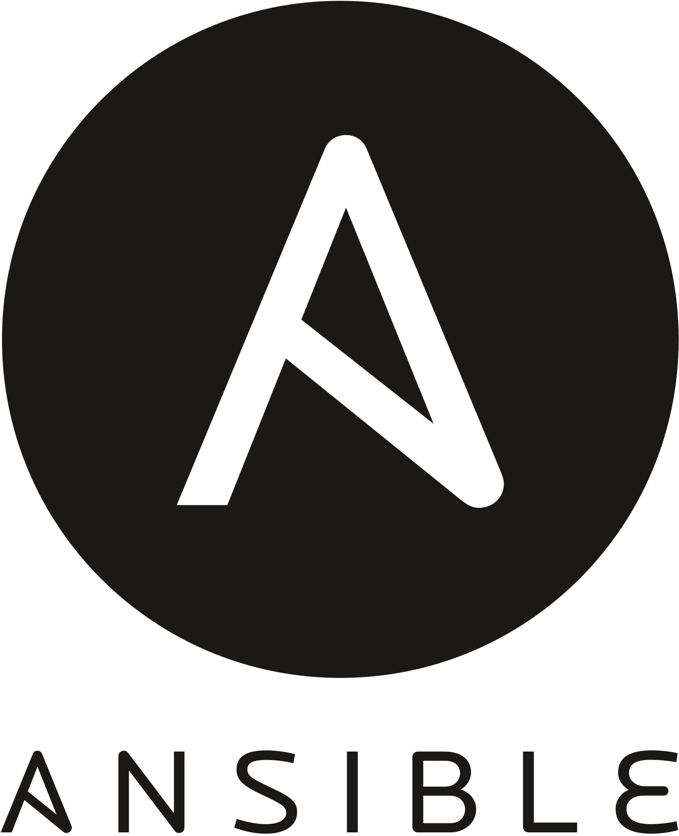
Procedural Approach
In this the programmer specifies the set of steps that must be taken by the system to reach a desirable architecture and configuration.
Essentially, the developer provides the device the logical steps needed to complete a task.
Advantage:
  This is more of a traditional approach; therefore, has extensive documentation available, making it easier to learn, code and debug.
Disadvantage:
  This approach is not scalable as we this level of manual intervention is not possible on huge scale.

Slide 4

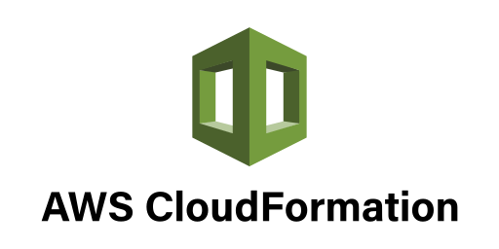
Declarative Approach
In this the developer tells the program what is the end result and allows the program to figure out the necessary steps.
As long as the final outcome is clearly specified, the steps to get there will be automatically generated.
Advantage:
  Teams can innovate and focus on solutions without getting caught up in the how of what they want to achieve.
Disadvantage:
  There are also situations when declarative programming isn’t specific enough to adequately handle more complex functions.

Slide 5
Mutable and Immutable

Slide 6
Mutable Infrastructure
Essentially, it means the infrastructure will be continually updated, tweaked, and tuned to meet the ongoing needs of the purpose it serves.
Mutable Infrastructure extends to every server and switch that is unique. The IT staff knows each server, its quirks, and often has spent countless hours finding where the problem came from just to resolve it because that is faster and far less scary than the idea of rebuilding the system in question.
To solidify the idea of how common mutable infrastructure is in the IT industry, this is a common use case that shows a server evolving through continually being updated in-place.

Slide 7
Immutable Infrastructure
The concept for immutable infrastructure is to build the infrastructure components to an exact set of specifications. No deviation, no changes.
So instead of upgrading devices in the field, those devices are now immutable and the whole device needs to be replaced. This provides a level of consistency that makes support easier.
Infrastructure as Code is the ideal way to create immutable infrastructure. Run it on virtualized platforms and public cloud providers, and you have what is commonly referred to as DevOps.

Slide 8
Stateful VS Stateless
Parameters | Stateful | Stateless
State | A Stateful server remember client data(state) from one request to the next. | A Stateless server does not remember state information.
Programming | Stateful server is harder to code. | Stateless server is straightforward to code.
Efficiency | More because client do not have to provide full file information every time they perform an operation. | Less because information needs to be provided.
Crash Recovery | Difficult due to loss of information. | Can easily recover from failure because there is no state that must be restored.
Information transfer | The client can send less data with each request. | The client must specify complete file name in each request.

Slide 9
Imperative Approach
Imperative also known as procedural-based approach. The imperative model focuses on how you do something.
In imperative, you specify a list of steps the IaC tool should follow to provision a new resource. You tell your IaC tool how to create each environment using a sequence of command imperatives. Chef is a popular imperative IaC tool, and both Ansible and Salt have some support for imperative programming as well.
Declarative Approach
Declarative also known as model-based approach. The declarative model focuses on what you want, but not how to make something happen.
In declarative, you specify the name and properties of the infrastructure resources you wish to provision, and then the IaC tool figures out how to achieve that end result on its own. You declare to your IaC tool what you want, but not how to get there. Some examples of popular IaC tools that use the declarative programming paradigm include Terraform, Puppet, Ansible, and CloudFormation.

Slide 10
Idempotency and Consistency :
An operation exhibits idempotency, if it can be repeated over and over again so as to get the same result, without causing any harm to the system.
Idempotency as a function
Need of Idempotency?
Example of idempotent behavior.
Consistency w.r.t to automation means the ability of a process/operation to be repeated time and again to arrive at the same result.
How consistency came into the picture?
Benefits of following consistency

Slide 11
Push and pull
Push – In push config management tool, the main server pushes the config to the nodes. In other words, it is the main server that initiates communication. Example – Ansible
Pull – In pull config management tool, the nodes pull the config info from the server via an agent/client. Examples – Chef & Puppet.
Advantages of Push based config management –
• Control over entire system
• Easier to use
Advantages of Pull based config management –
• Easier to configure new nodes
• Easier scalability

Slide 12
Thank you

